Slide 1

Climate Change Prediciton using Time Series Analysis
Project Supervisor: Dr.N.S.USHA
Name of the Student: HASHWANTH KUMAR. H
Register Number: 40110449

Slide 2
Presentation Outline
Course Certificate
Introduction
Objectives
System Architecture / Ideation Map
Module Implementation
Application Snapshots
Results and Discussions
Conclusions $ Future work
References

Slide 3
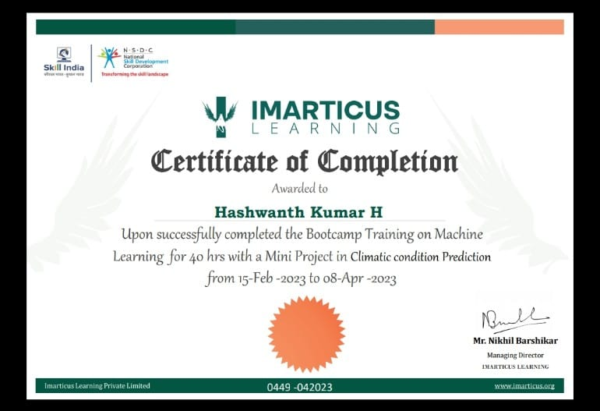
Course Certificate

Slide 4
Introduction
Climatic changes are predominantly governed by the changes in temperature and precipitation.
Time series data is a collection of observations obtained through repeated measurements over time. It is also reffers to as time-stamped data.
Analysis of time series invariably involves the evaluation of trends and seasonality in the data
This project can be used for Financial Analysis , Weather Analysis , Network Data Analysis, HealthCare Analysis.

Slide 5
Objective
The objectives of this study is to analyse and predict the temperature series
The goals of climate change prediction is to reduce risk and vulnerability to climate change, strengthen resilience, enhance well-being and the capacity to anticipate, and respond successfully to change.
It allows us to understand and compare things without losing the important, shared background of ‘time’
It allows us to make forecasts

Slide 6
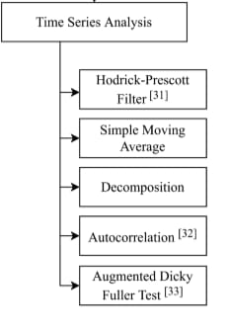
System architecture / Ideation Map

Slide 7
Project Implementation
An estimate of global surface temperature change Dataset need to be collected and downloaded in CSV format.
Wrangling temperature data:
We will first wrangle Global Surface temperature anomaly data. In doing so, we will look at several things:
Using a DateTime index
Using a DateTime index can allow us to be more productive in our time series manipulation; it will allow us to make selections and take slices using timestamps or time ranges.
Basic manipulation and dealing with missing values
In order to populate our DataFrame, we will basically be stepping through a slice of the raw data that we are interested in (i.e. the year and month columns), and assigning the corresponding anomaly values to our new DataFrame.

Slide 8
Project Implementation
Resampling to a different frequency
it seems that over such a long time period the data is too granular to visualize nicely. Pandas offers a very convenient function known as ‘resample’, which can change our frequency from months to years
Slicing and Searching
DateTime indexes make for convenient slicing of data.
Visualizing:
Now that we have our datasets nicely wrangled, let’s look at how to plot them. We will be using two plotting libraries, namely:
Matplotlib
Plotly
Plotting with Matplotlib
Matplotlib is a very popular 2D plotting library for Python, and can easily be downloaded using pip.

Slide 9
Project Implementation
Time Series Correlation:
Although it seems relatively obvious that both series are trending upwards, what we’d actually like to do here is determine whether the temperature change.
Decomposition:
As was stated at the beginning , it can be useful to think of a time series as being made up of several components; and luckily for us, Prophet can help us break up our model into these components — so that we can see them visually.By default, you’ll see the trend and yearly seasonality of the time series.
Autocorrelation
Autocorrelation is an important concept to understand when doing time series analyses; the term refers to (and is a mathematical representation of) the degree of similarity between a given time series, and a lagged version of itself over successive time intervals.

Slide 10
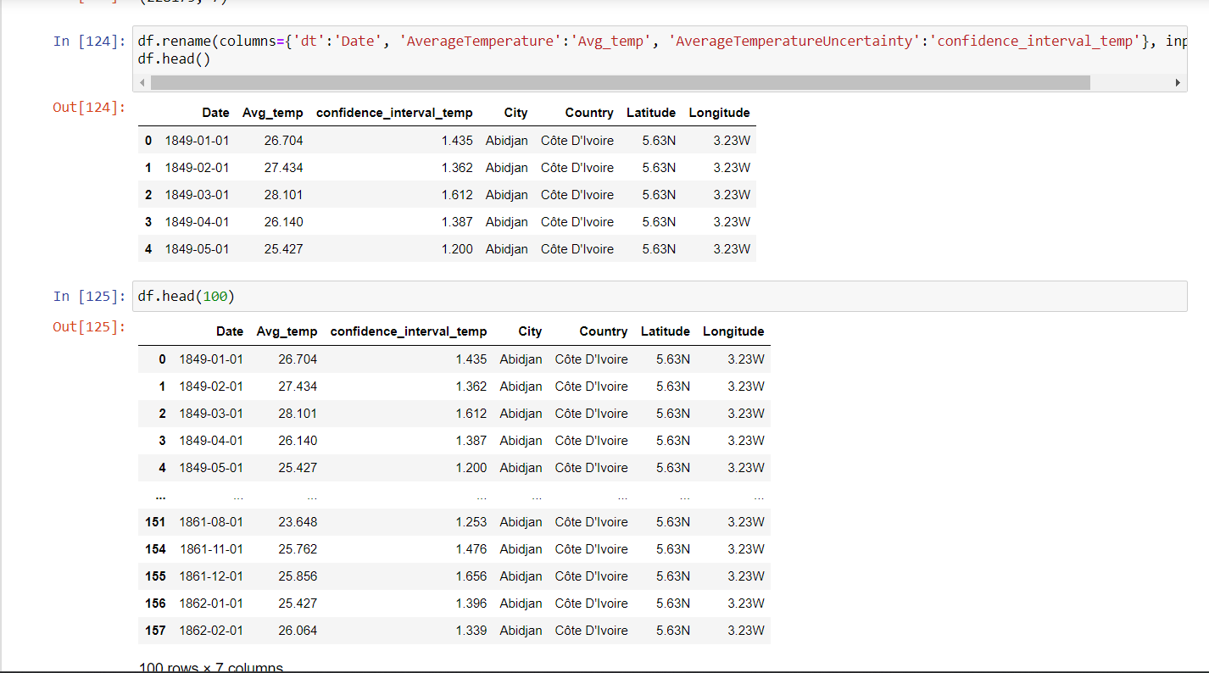
Application Snapshots

Slide 11
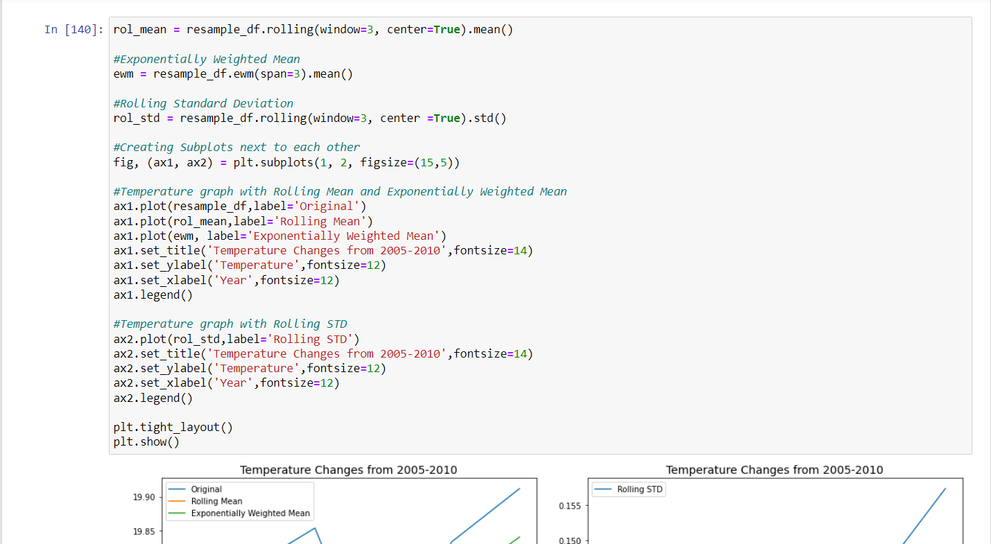
Application Snapshots

Slide 12
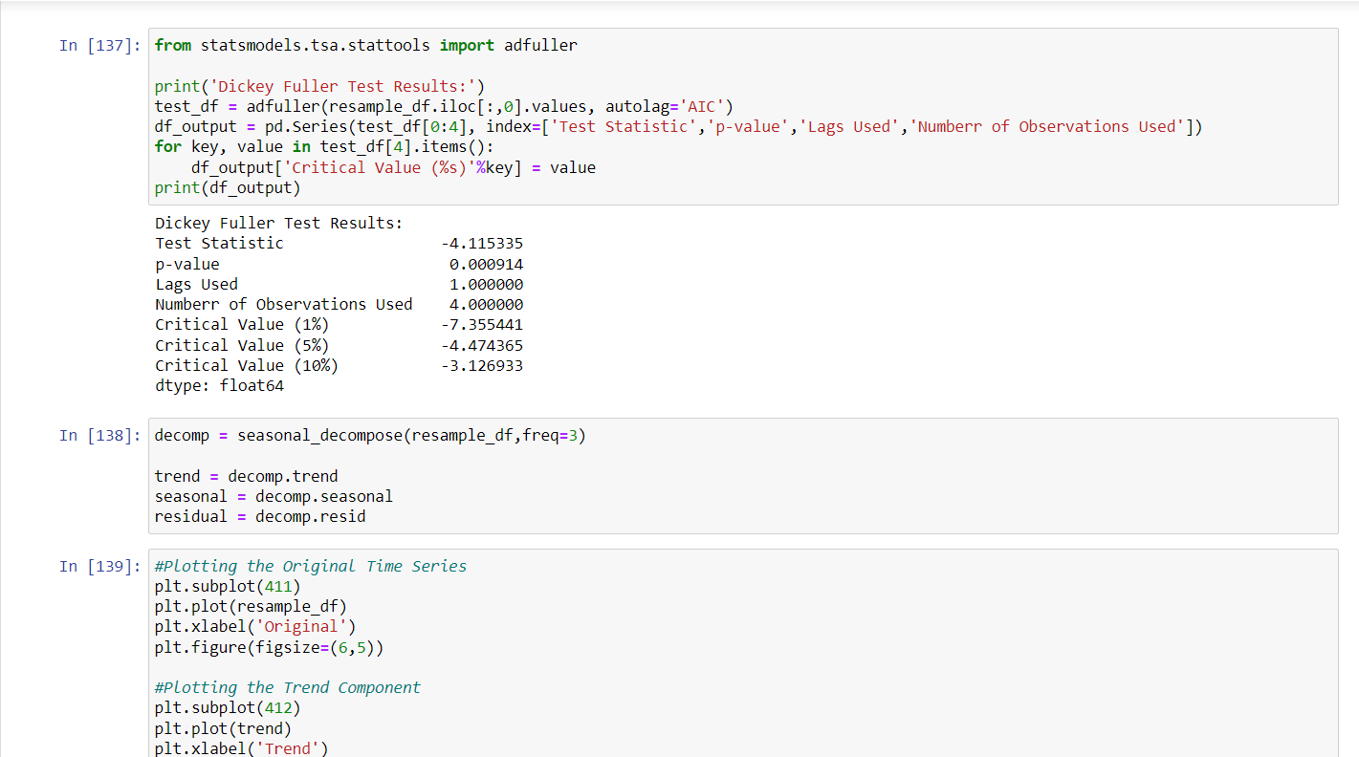
Application Snapshots

Slide 13
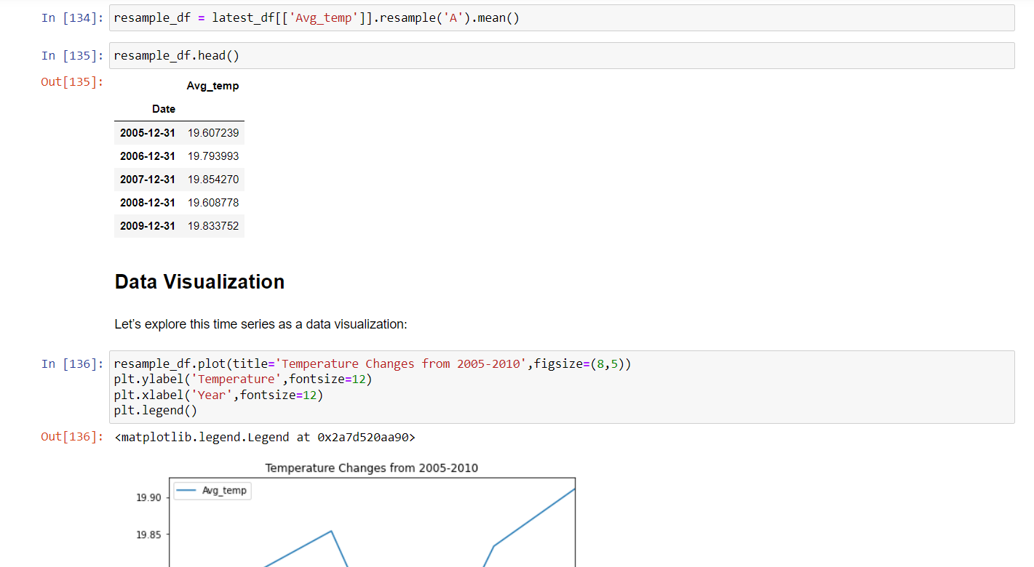
Application Snapshots

Slide 14
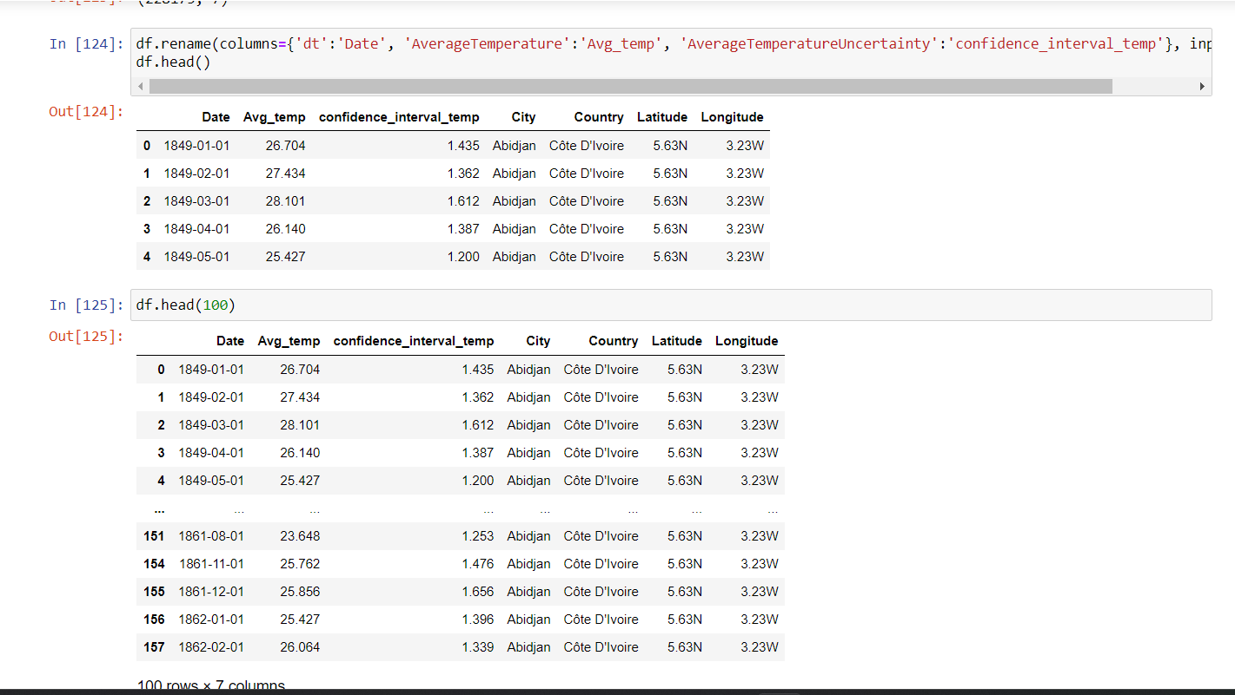
Application Snapshots

Slide 15
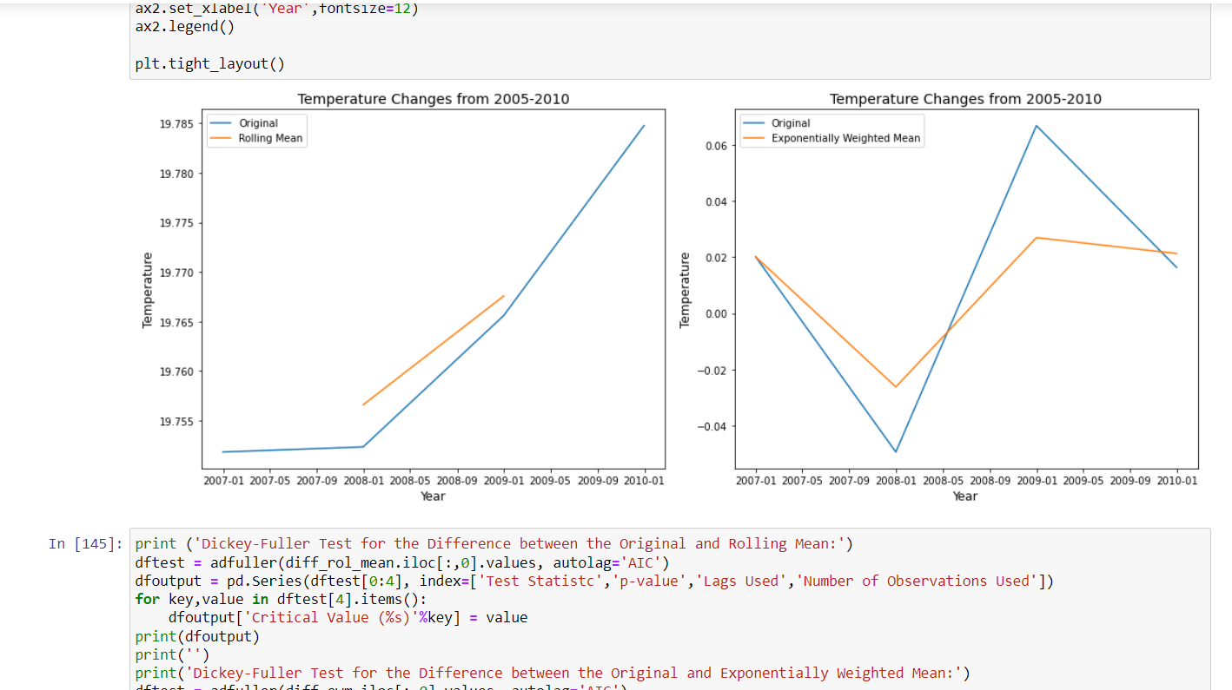
Application Snapshots

Slide 16
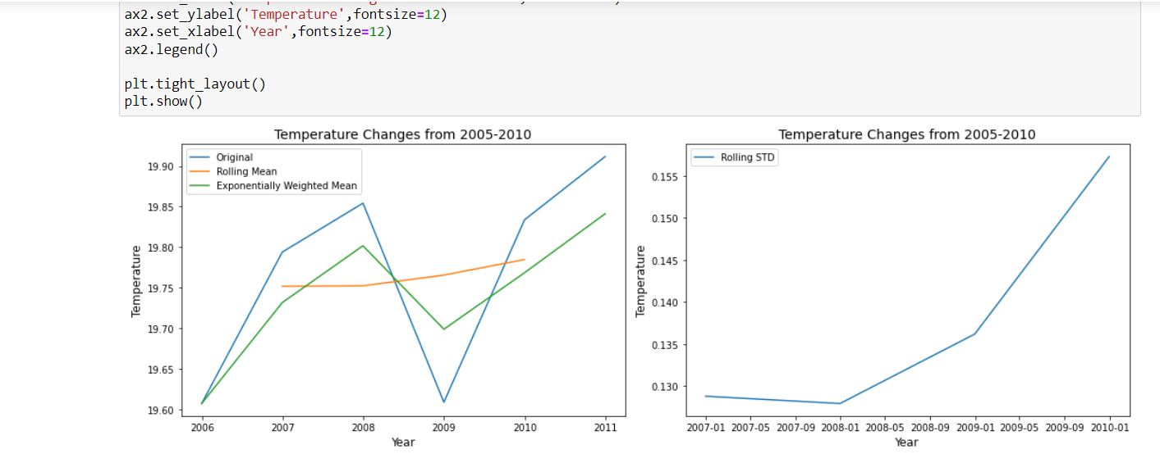
Application Snapshots

Slide 17
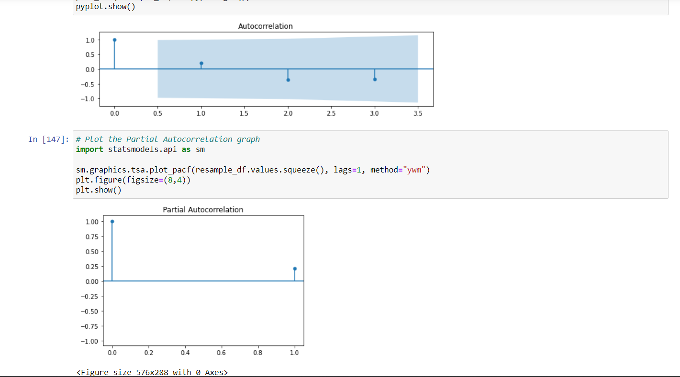
Application Snapshots

Slide 18
Conclusion
The main conclusion for Climate models is for improving our understanding and predictability of climate behavior on seasonal, annual, decadal, and centennial time scales. Models investigate the degree to which observed climate changes may be due to natural variability, human activity, or a combination of both.
From the model we can understand the past, present and future global climate temperature. This combined with climate models, allows us to determine how both natural and manmade influences have and will impact changes in our climate.
The Climate Models is used to avoid an incomplete understanding of the climate system, that is an imperfect ability to transform our knowledge into accurate mathematical equations.
An advantage of GlobalClimateModels is their ability to perform multiple simulation experiments using different climate scenarios.

Slide 19
References
https://www.kaggle.com/datasets/berkeleyearth/climate-change-earth-surface-temperature-data?select=GlobalLandTemperaturesByCountry.csv
https://github.com/Arunfi143/Our_Project_repo
https://towardsdatascience.com/time-series-analysis-and-climate-change-7bb4371021e

Slide 20
Thank You

